Slide 1
Exploring the Unconscious
Team Members: Ruben Valdes Jr., Daniel Antonio Product Owner: Mario Eraso
Instructor: Masoud Sadjadi School of Computing and Information Sciences Florida International University
Final Presentation
2017
The logo of your project
Notes:
7 seconds.( I will select 2 best slides (i will give them extra points and students will present for CIS committee)
Greet your audience, thank them for attending your presentation, introduce yourself, introduce your project, introduce your team members, and quickly indicate what each of you did in a high-level manner, and put more emphasis on your part/contribution.

Slide 2
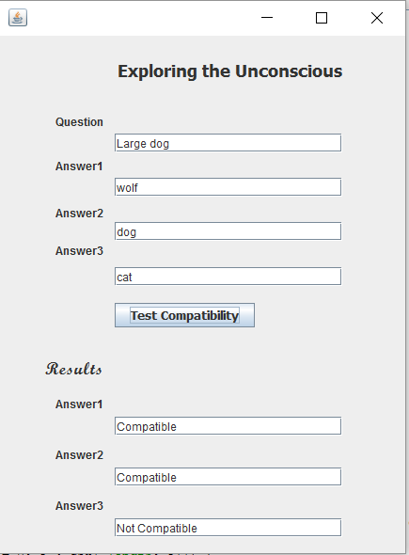
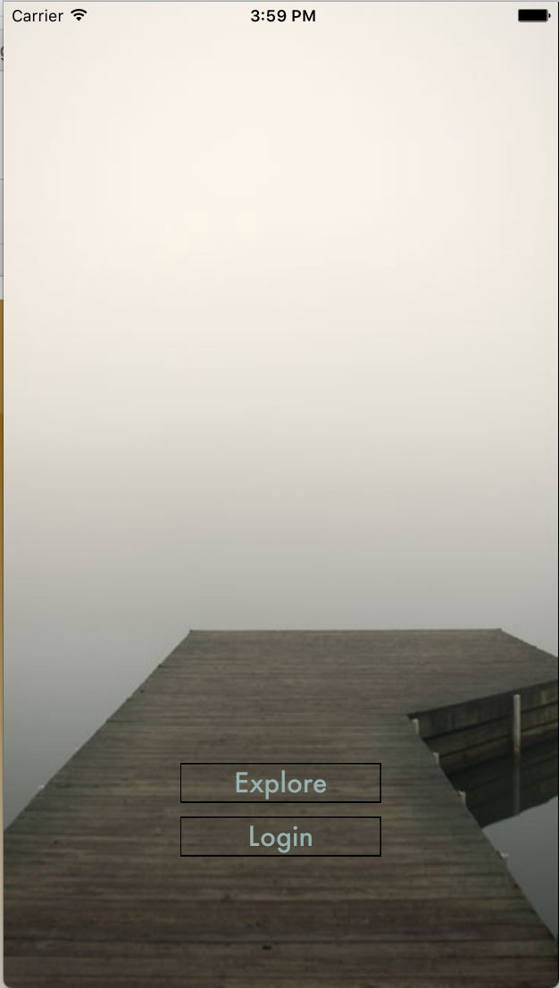
Project definition
Notes:
10 seconds.
Introduce the problem that the whole project (in all versions) tackles with GIF or screenshot.

Slide 3
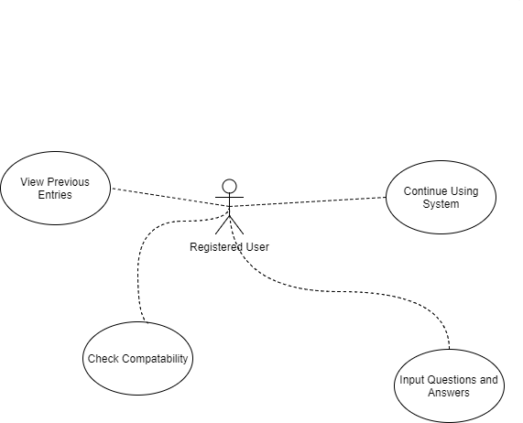
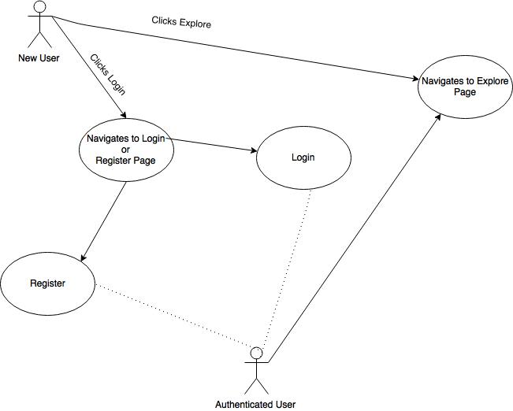
Requirements: Use Cases
Notes:
5 seconds
Show the Use Case Diagram for the whole project. Highlight your use cases.

Slide 4
System Design: Architecture
Model-View-Controller(MVC)
This was seen as the best design because we had user data as well as the question data to model for our database.
We had to use a controller to access the fields in the model and serve them to the view as a service.
MVC was methodology that facilitated this the best due to the fact that we had all parts the model, the view, and the controller that went into building the application.
System Requirements:
requires IOS 8.0 or later compatible with Iphone, Ipod touch.
Android 4.4 or higher
128 MB of RAM
32 MB of storage
Android or IOS required
Notes:
20 seconds
System design: Highlight the parts that you contributed to them.
1. System decomposition; identify the architecture patterns used
2. System deployment – h/w and s/w requirements

Slide 5
Minimal Class Diagram
Creational patterns: Factory Method for Algorithm code, Builder Pattern for Front-end code.
Structural patterns: Bridge Method for Algorithm code, Adapter Pattern for Front-End code.
Behavioral patterns: Chain-of-Responsibility and Command Pattern for both Algorithm and Front-End code.
Notes:
10 seconds.Minimal class diagram. Highlight the classes that you created/modified
Identify the design patterns used (one or more slides).

Slide 6
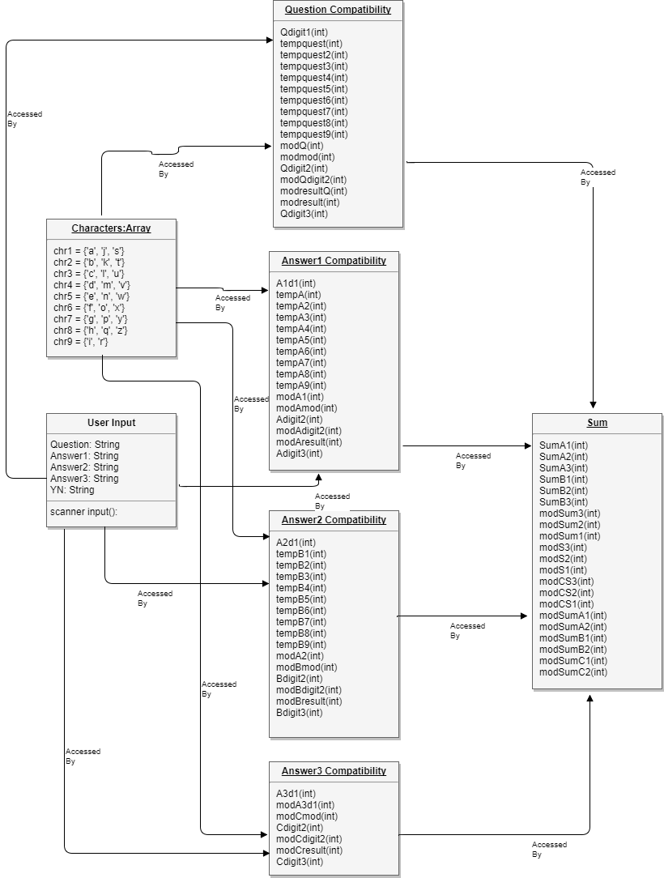
Minimal Class Diagram
Notes:
10 seconds.Minimal class diagram. Highlight the classes that you created/modified
Identify the design patterns used (one or more slides).

Slide 7
User Stories
1.Compatibility
2.Input
3.Making an Account
4.Login to System
5.Navigate to Explore
6.Continuation
Notes:
5 seconds.
List the user stories that you worked on them.(put in order of importance). Stay focused on the parts that you have been working.

Slide 8
User Story #1
Name: Compatibility
Actor: User
Preconditions: As a user I must be able to check the compatibility of my question and answer through my own input
Description <Flow of events>: - User is prompted as to whether they wish to check that the question and answers they have inputted are compatible. - User inputs “Y”. - System outputs whether the question and answers are compatible. - User is prompted whether they wish to test another question and answers. Exit condition: User types in “N” that they do not wish to input anymore questions or answers
Notes:
60 seconds
The tile of user story
The most important user story you worked on it. You have to describe this one very well and be proud of that.
Please present and show the complexity of your work, code, algorithms, and technical challenges and technologies you have used. (you could use screenshot if you want. Visual presentations are better than text presentation)
Go into the details of the most important/significant tasks using bullet lists or visual graphs or state chart diagram
Sequence Diagram for this user story is mandatory (in another separate page if required)
Demo using screenshots or GIF (in another separate page if required)

Slide 9
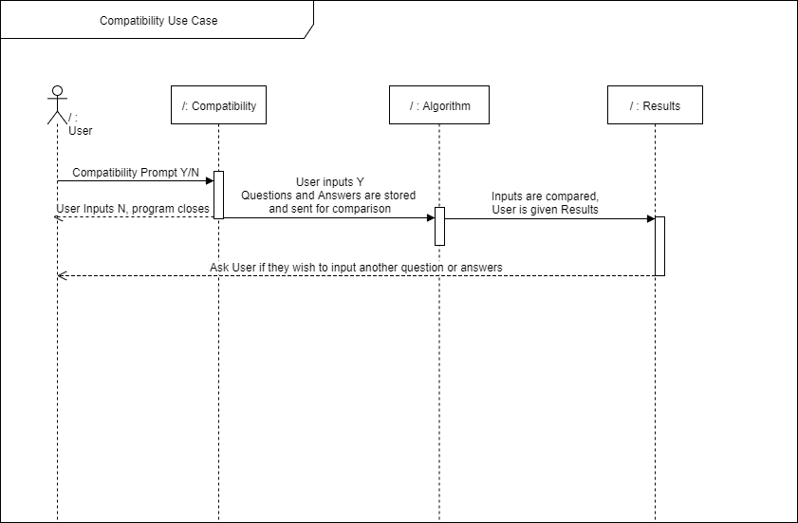
User Story #1
Notes:
60 seconds
The tile of user story
The most important user story you worked on it. You have to describe this one very well and be proud of that.
Please present and show the complexity of your work, code, algorithms, and technical challenges and technologies you have used. (you could use screenshot if you want. Visual presentations are better than text presentation)
Go into the details of the most important/significant tasks using bullet lists or visual graphs or state chart diagram
Sequence Diagram for this user story is mandatory (in another separate page if required)
Demo using screenshots or GIF (in another separate page if required)

Slide 10
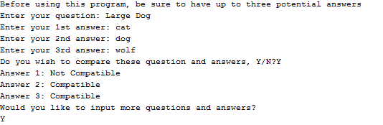
User Story #1
Notes:
60 seconds
The tile of user story
The most important user story you worked on it. You have to describe this one very well and be proud of that.
Please present and show the complexity of your work, code, algorithms, and technical challenges and technologies you have used. (you could use screenshot if you want. Visual presentations are better than text presentation)
Go into the details of the most important/significant tasks using bullet lists or visual graphs or state chart diagram
Sequence Diagram for this user story is mandatory (in another separate page if required)
Demo using screenshots or GIF (in another separate page if required)

Slide 11
User Story #2
Name: Input
Actor: User
Preconditions: As a user I must have fields to input my desired question and answer
Description <Flow of events>: User is prompted that they must have a minimum of three answers before using this program. User is prompted to input a single question. User inputs their question. User is prompted to input there 1st answer. User inputs their answer. User is prompted to input their 2nd answer. User inputs their answer. User is prompted to input their final answer. User inputs their answer. User is prompted whether they wish to test another question and answers. Exit condition: User types in “N” or “Y.
Exceptions: User inputs a question or answer with a numerical value in it. System informs user that they cannot input numerical values directly, they must write them out. Program is terminated.
Notes:
20 seconds
The tile of user story
Please present and show the complexity of your work, code, algorithms, and technical challenges and technologies you have used. (you could use screenshot if you want. Visual presentations are better than text presentation) - Go into the details of the most important/significant tasks using bullet lists or visual graphs or state chart diagram - Demo using screenshots or GIF (in another separate page if required)
Sequence Diagram for this user story is optional

Slide 12
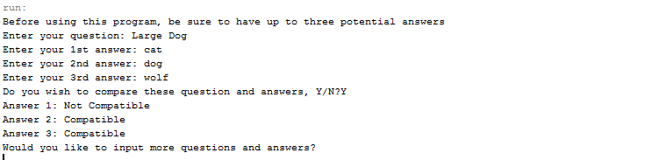
User Story #2

Slide 13
User Story #3
Participating actor: Guest
Entry Condition: As an User I must be able to create an account so that I can track my progress with the app and I can manage my user settings.
Exit Condition: Guest clicks “Register” after creating their profile
Flow of Events:
Guest selects “Create an Account”
System displays an account setup page that asks for First Name, Last Name, E-Mail Address, E-Mail confirmation, Password, and Password confirmation.
Guest fills out requested information and presses “Create Account”
System directs Guest back to the login screen.
Notes:
20 seconds
The tile of user story
Please present and show the complexity of your work, code, algorithms, and technical challenges and technologies you have used. (you could use screenshot if you want. Visual presentations are better than text presentation) - Go into the details of the most important/significant tasks using bullet lists or visual graphs or state chart diagram - Demo using screenshots or GIF (in another separate page if required)
Sequence Diagram for this user story is optional

Slide 14
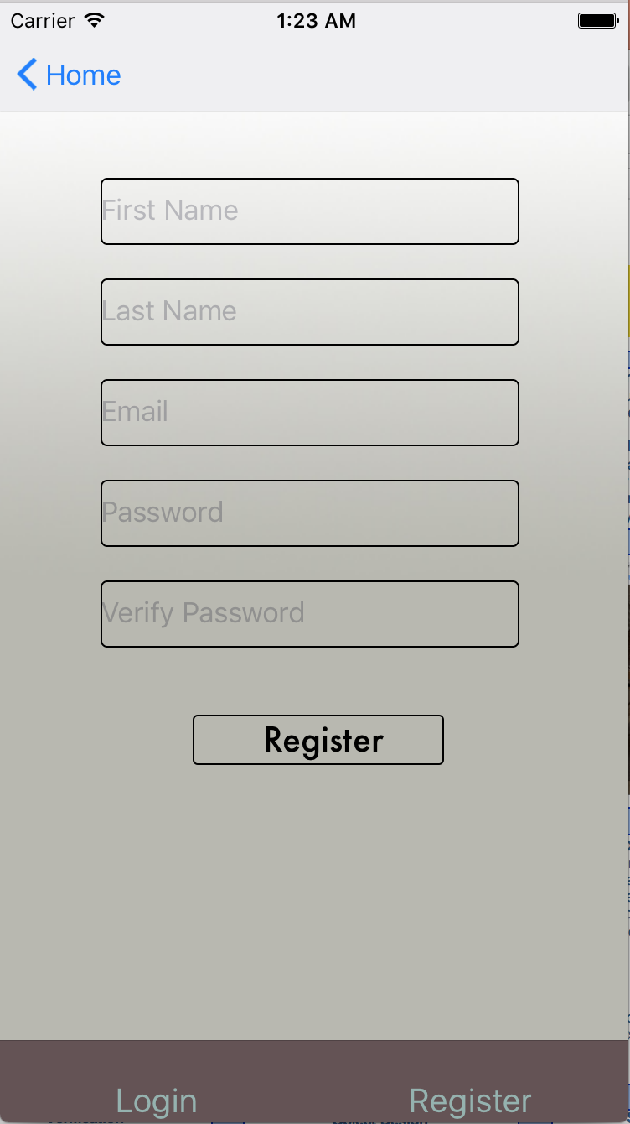
User Story #3
Notes:
20 seconds
The tile of user story
Please present and show the complexity of your work, code, algorithms, and technical challenges and technologies you have used. (you could use screenshot if you want. Visual presentations are better than text presentation) - Go into the details of the most important/significant tasks using bullet lists or visual graphs or state chart diagram - Demo using screenshots or GIF (in another separate page if required)
Sequence Diagram for this user story is optional

Slide 15
User Story #4
Description:
As a User I must be able to enter my credentials in order to log into my profile within the app
Acceptance Criteria:
First name and last name must be displayed
Match score must be shown
Recent questions must be shown
Notes:
20 seconds
The tile of user story
Please present and show the complexity of your work, code, algorithms, and technical challenges and technologies you have used. (you could use screenshot if you want. Visual presentations are better than text presentation) - Go into the details of the most important/significant tasks using bullet lists or visual graphs or state chart diagram - Demo using screenshots or GIF (in another separate page if required)
Sequence Diagram for this user story is optional

Slide 16
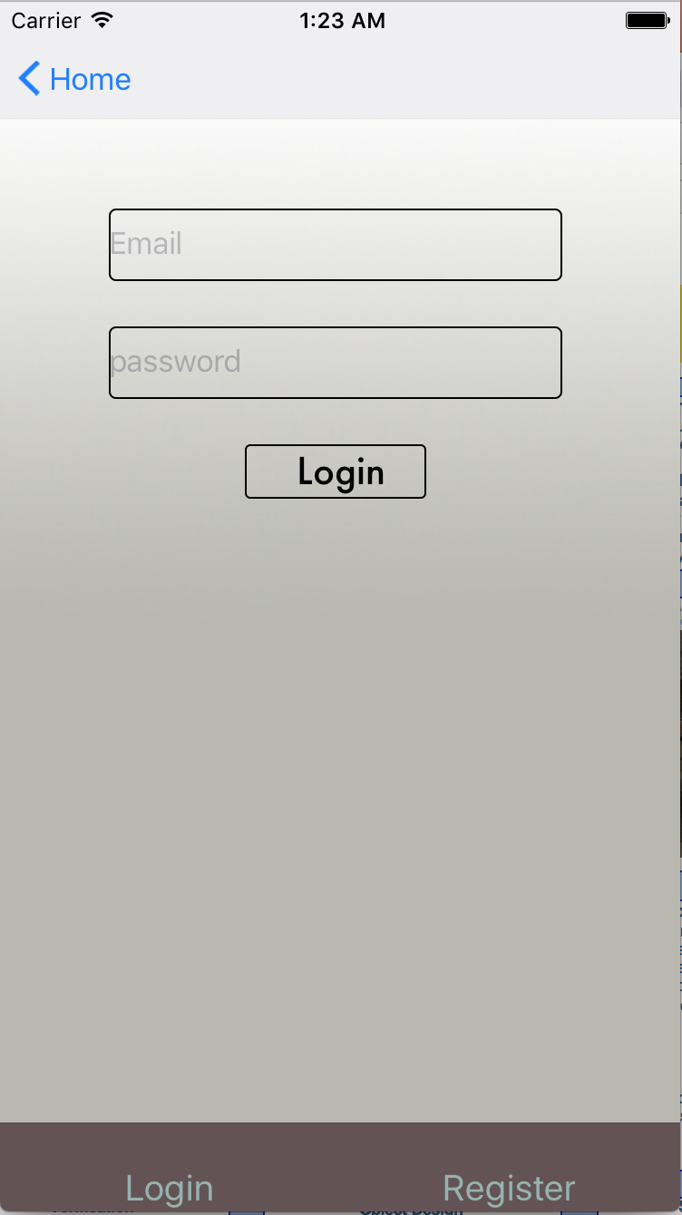
User Story #4
Notes:
20 seconds
The tile of user story
Please present and show the complexity of your work, code, algorithms, and technical challenges and technologies you have used. (you could use screenshot if you want. Visual presentations are better than text presentation) - Go into the details of the most important/significant tasks using bullet lists or visual graphs or state chart diagram - Demo using screenshots or GIF (in another separate page if required)
Sequence Diagram for this user story is optional

Slide 17
User Story #5
Description:
As a user I must be able to navigate to the explore page to check phrase compatibility.
Acceptance Criteria:
I must see a list of input fields for the question and answer.
I must be able to see the button to click and compare my phrases
Notes:
20 seconds
The tile of user story
Please present and show the complexity of your work, code, algorithms, and technical challenges and technologies you have used. (you could use screenshot if you want. Visual presentations are better than text presentation) - Go into the details of the most important/significant tasks using bullet lists or visual graphs or state chart diagram - Demo using screenshots or GIF (in another separate page if required)
Sequence Diagram for this user story is optional

Slide 18
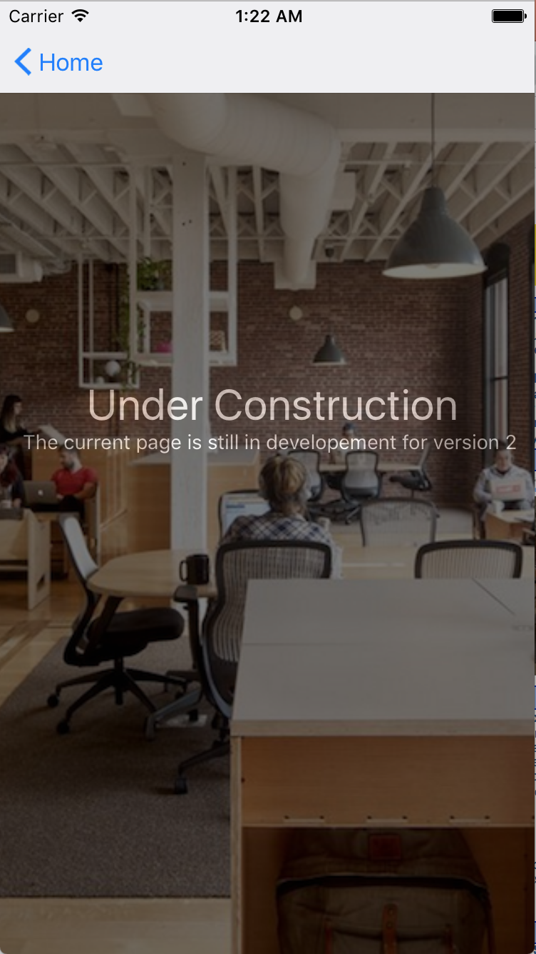
User Story #5
Notes:
20 seconds
The tile of user story
Please present and show the complexity of your work, code, algorithms, and technical challenges and technologies you have used. (you could use screenshot if you want. Visual presentations are better than text presentation) - Go into the details of the most important/significant tasks using bullet lists or visual graphs or state chart diagram - Demo using screenshots or GIF (in another separate page if required)
Sequence Diagram for this user story is optional

Slide 19
User Story #6
Use Case Name: Continuation Actor: User Preconditions: As a user I must have the option to quit using the system Description <Flow of events>: User is prompted whether they wish to test another question and answers. User inputs “Y” User inputs the next set of question and answers Exit condition: User types in “N”.
Notes:
20 seconds
The tile of user story
Please present and show the complexity of your work, code, algorithms, and technical challenges and technologies you have used. (you could use screenshot if you want. Visual presentations are better than text presentation) - Go into the details of the most important/significant tasks using bullet lists or visual graphs or state chart diagram - Demo using screenshots or GIF (in another separate page if required)
Sequence Diagram for this user story is optional

Slide 20
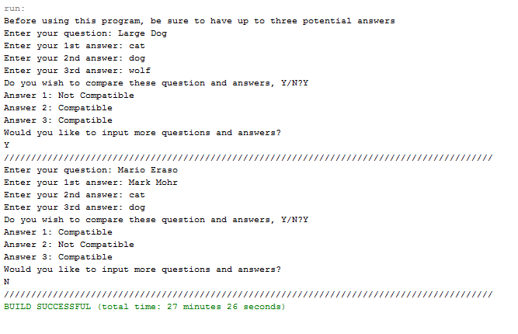
User Story #6

Slide 21
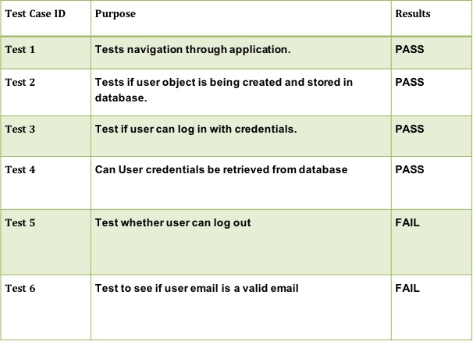
Test Suites and Test Cases
Test Case ID | Purpose | Results
Test 1 | Test whether the system runs the compatibility function. | PASS
Test 2 | Test that the compatibility function will run for more than one answer. | PASS
Test 3 | Test that the computations performed by the compatibility function are mathematically correct based on the algorithm provided. | PASS
Test 4 | Test whether the system prevents the user from inputting numeric values. | PASS
Test 5 | Test whether the user can continue using the system after the initial input. | PASS
Test 6 | Test the compatibility of the phrase “large dog” with “wolf”, “dog” and “cat”. | PASS
Test 7 | Test the compatibility of two names “Mario Eraso” and “Mark Mohr”. | PASS
Test 8 | Test the compatibility of the word “table” with itself. | PASS
Test 9 | Test whether the system will output a “Not Compatible” for the words “bus” and “car”. | FAIL
Test 10 | Test revised code for whether it outputs a “Not Compatible” for the words “bus” and “car”. | PASS
Test 11 | Test to make sure all variables are reset after each iteration of the program. | PASS
Notes:
10 seconds
A description of verification process and Test Suites and Test Cases for one of the use cases.
1 One sunny day and one rainy day for the implemented use cases (one or more slides).
2 Automated test scripts for the implemented use cases (if any) (one or more slides).

Slide 22







Summary
We are both very proud and happy with work that have done and what we have accomplished to make this project a success. From our daily scrum meetings to our maintaining version control using github to our UML designs, we have worked very hard move the needle on this project.
Questions?
Thank You!
Daniel Antonio
Daniel.b.antonio@gmail.com
(407)-802-9442
Ruben Valdes Jr.
lelav6@comcast.net
(305)-206-7086
Notes:
10 seconds
Summarize your contribution, mention your effort for Scrum, Mingle, Github, Google Drive Documentation and minutes
Include your contact information
Ask if anyone has any questions for you.
Thank your audience

